Slide 1
A Portrait
of

Slide 2
1 Corinthians 13:4 Love is patient,
love is kind.
It does not envy,
it does not boast,
it is not proud.

Slide 3
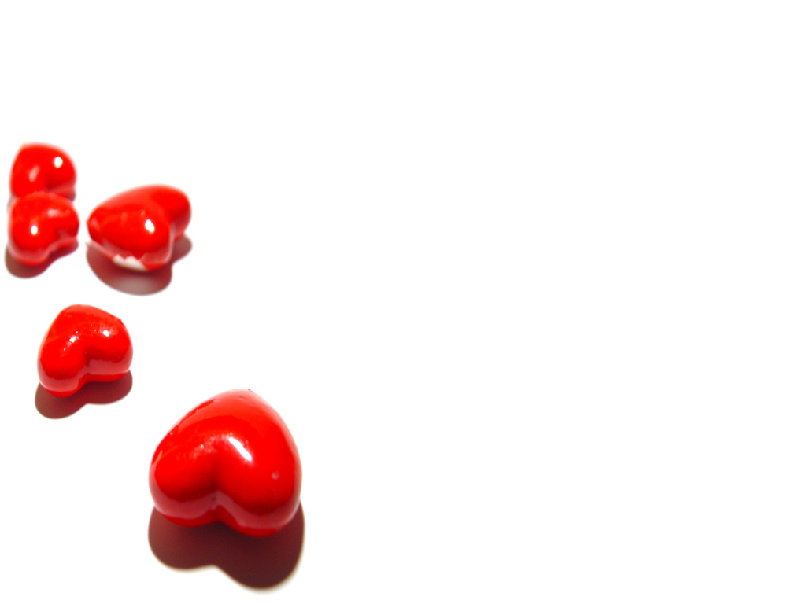
"A Portrait of Love"
1. Love endures an offense without seeking revenge against the one who committed it (vs. 4a)

Slide 4
1 Corinthians 13:4 Love is patient,
love is kind.
It does not envy,
it does not boast,
it is not proud.

Slide 5
"A Portrait of Love"
2 Love is naturally disposed to do acts of kindness for others (vs. 4b)

Slide 6
1 Corinthians 13:4 Love is patient,
love is kind.
It does not envy,
it does not boast,
it is not proud.

Slide 7
"A Portrait of Love"
3. Love isn't jealous but it is content with its lot (vs. 4c)

Slide 8
1 Corinthians 13:4 Love is patient,
love is kind.
It does not envy,
it does not boast,
it is not proud.

Slide 9
"A Portrait of Love"
4. Love isn't boastful but it is modest, recognizing that the credit for everything belongs ultimately to the Lord (vs. 4d)

Slide 10
1 Corinthians 13:4 Love is patient,
love is kind.
It does not envy,
it does not boast,
it is not proud.

Slide 11
"A Portrait of Love"
5. Love isn't conceited but it is humble, recognizing that all that it has is by the grace of God (vs. 4e)

Slide 12
1 Corinthians 13:4 Love is patient,
love is kind.
It does not envy,
it does not boast,
it is not proud.

Slide 13
A Portrait
of

