Slide 1
A Portrait
of
Part 2

Slide 2
1 Corinthians 13 page 1786

Slide 3
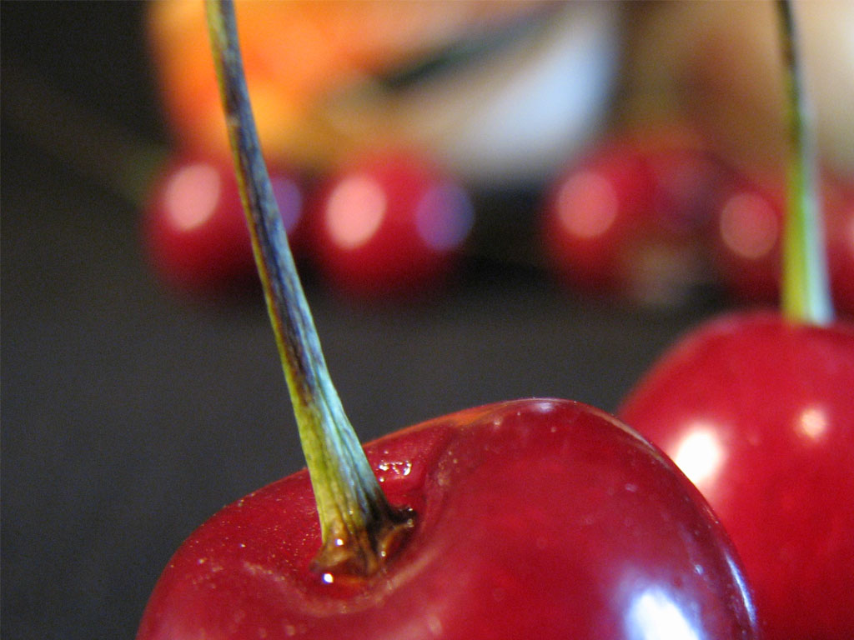
Last Year part 1

Slide 4
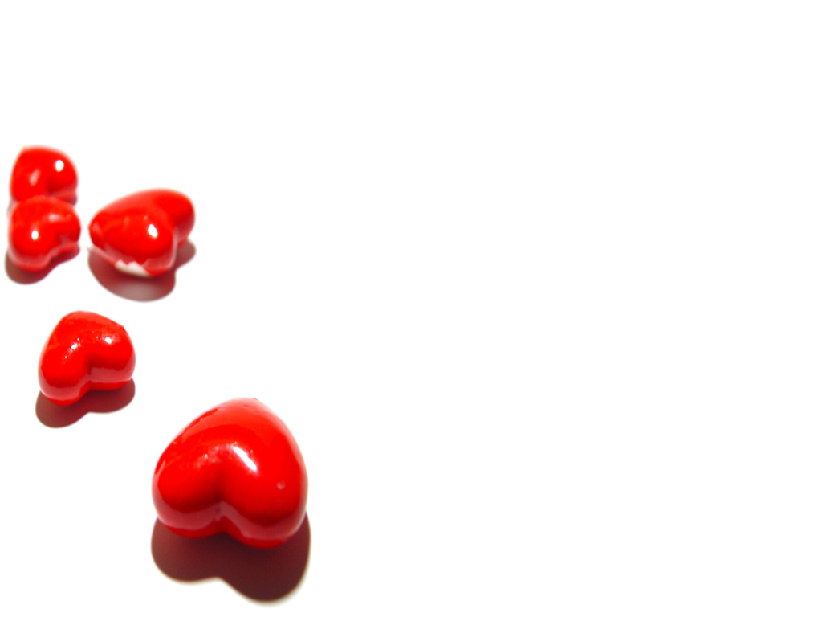
"A Portrait of Love"
1. Love endures an offense without seeking revenge against the one who committed it (V4a)
Last Year

Slide 5
"A Portrait of Love"
2 Love is naturally disposed to do acts of kindness for others (V4b)
Last Year

Slide 6
"A Portrait of Love"
3. Love isn't jealous but it is content with its lot (V4c)
Last Year

Slide 7
"A Portrait of Love"
4. Love isn't boastful but it is modest, recognizing that the credit for everything belongs ultimately to the Lord (V4d)
Last Year

Slide 8
"A Portrait of Love"
5. Love isn't conceited but it is humble, recognizing that all
that it has is by the grace of God (V4e)
Last Year

Slide 9
A Portrait
of
Part 2

Slide 10
1 Corinthians 13:5 It is not rude,
it is not self-seeking,
it is not easily angered,
it keeps no record of wrongs.

Slide 11
"A Portrait of Love"
1. Love isn't indecorous, but maintains a proper decorum (V5a)

Slide 12
1 Corinthians 13:5 It is not rude,
it is not self-seeking,
it is not easily angered,
it keeps no record of wrongs.

Slide 13
1 Corinthians 13:5 It is not rude,
it is not self-seeking,
it is not easily angered,
it keeps no record of wrongs.

Slide 14
"A Portrait of Love"
2. Love isn't selfish, but it seeks the good of others, even though there isn't a single thing in it for itself (V5b)

Slide 15
1 Corinthians 13:5 It is not rude,
it is not self-seeking,
it is not easily angered,
it keeps no record of wrongs.

Slide 16
1 Corinthians 13:5 It is not rude,
it is not self-seeking,
it is not easily angered,
it keeps no record of wrongs.

Slide 17
"A Portrait of Love"
3. Love isn't enraged by the injurious (hurtful) things that are done to it, but it takes those things in stride (V5c)

Slide 18
1 Corinthians 13:5 It is not rude,
it is not self-seeking,
it is not easily angered,
it keeps no record of wrongs.

Slide 19
1 Corinthians 13:5 It is not rude,
it is not self-seeking,
it is not easily angered,
it keeps no record of wrongs.

Slide 20
"A Portrait of Love"
4. Love doesn't hold the evil that is done to it against the one who did it, but it forgives that person and treats that person on a personal level just as though the evil hadn't been done (V5d)

Slide 21
1 Corinthians 13:5 It is not rude,
it is not self-seeking,
it is not easily angered,
it keeps no record of wrongs.

Slide 22
1 Corinthians 13:6 Love does not delight in evil
but rejoices with the truth.

Slide 23
"A Portrait of Love"
5. Love doesn't sympathize with unrighteousness (V6a)

Slide 24
1 Corinthians 13:6 Love does not delight in evil
but rejoices with the truth.

Slide 25
A Portrait
of
Part 2

