Slide 1
Next Sunday

Slide 2
“The fear of the LORD is the beginning of wisdom.” Psalm 111:10
#Crossroads

Slide 3
TRUE WISDOM
James 3:13-18 page 1883

Slide 4
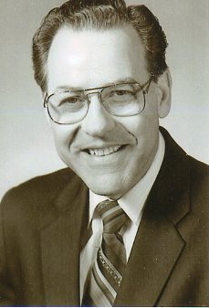
Rev. William Harding

Slide 5
TRUE WISDOM
James 3:13-18 page 1883

Slide 6
James 3:13-18 Who is wise and understanding among you? Let him show it by his good life, by deeds done in the humility that comes from wisdom. But if you harbor bitter envy and selfish ambition in your hearts, do not boast about it or deny the truth. Such "wisdom" does not come down from heaven but is earthly, unspiritual, of the devil.

Slide 7
For where you have envy and selfish ambition, there you find disorder and every evil practice. But the wisdom that comes from heaven is first of all pure; then peace-loving, considerate, submissive, full of mercy and good fruit, impartial and sincere. Peacemakers who sow in peace raise a harvest of righteousness.

Slide 8
TRUE
WISDOM
1. The Origin of True Wisdom V17a
It comes from God
who is in Heaven

Slide 9
TRUE
WISDOM
2. The Characteristics of True Wisdom V17

Slide 10
It is morally pure
It is disposed to live in peace with others
It is gentle in dealing with others
It is compliant when it is right and proper to be compliant
It habitually shows compassion to them who are in need
It habitually does works that are morally good and beneficial to others
It is impartial in its treatment of others
The
Characteristics
of
True Wisdom
V17
WISDOM

Slide 11
James 2:1-4 My brothers, as believers in our glorious Lord Jesus Christ, don't show favoritism. Suppose a man comes into your meeting wearing a gold ring and fine clothes, and a poor man in shabby clothes also comes in. If you show special attention to the man wearing fine clothes and say, "Here's a good seat for you," but say to the poor man, "You stand there" or "Sit on the floor by my feet," have you not discriminated among yourselves and become judges with evil thoughts?

Slide 12
It is morally pure
It is disposed to live in peace with others
It is gentle in dealing with others
It is compliant when it is right and proper to be compliant
It habitually shows compassion to them who are in need
It habitually does works that are morally good and beneficial to others
It is impartial in its treatment of others
It is sincere
The
Characteristics
of
True Wisdom
V17
WISDOM

Slide 13
TRUE
WISDOM
3. The Result
of Exercising
True Wisdom V18
It is that people get saved and
righteousness is produced in their lives

Slide 14
TRUE WISDOM

